Slide 1
Client Server & Peer to peer

Slide 2
Client server
Servers, providers of resources or functionality
Clients, consume the resources or functionality of the servers but do not provide functionality of there own.
A system can run several servers and can run zero or more clients
Usually, clients and servers are separate machines, connected over a network.

Slide 3


Slide 4
The client server model requires end to end connections.
The client MUST know the servers IP and which port to connect to.
Once the connection is established, all packets from the client (the IP endpoint ) contain the clients IP and port number so the server can respond .

Slide 5
Usage
Web sites
Ebay
Amazon
Streaming video
Date and time information
File transfer protocol (FTP)

Slide 6


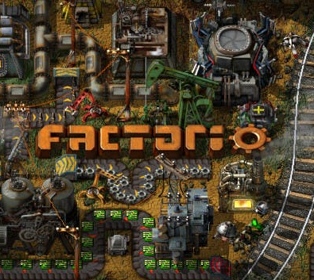

In games
We use this model for most kinds of games
Many games run servers on local computers and run a client along side.
Unreal tournament is an example of this.

Slide 7
For this to work
We need to know the IP address of the server
As we talked about in week one. We use Domain Name Servers (DNS) to translate google.com in to an IP address (8.8.8.8).
The address of the DNS is either stored in our Operating system or our request is automatically forwarded on to the ISP’s known DNS.
No matter which way you look at it, you ALWAYS need to know the servers IP to connect over the internet.

Slide 8
Peer to peer

Slide 9
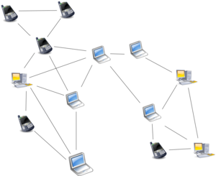
In a peer to peer network, nodes operate as both client and server.
Any node in the network can communicate with any other node.
There is no central point of connection in the network.
This increases network stability by making peers less dependant on any one point of failure.

Slide 10
For peer to peer to work we need to be able to connect to other peers.
This can be a problem if there is not centralized server for use to connect to.
In private networks, this is easy, we just broadcast a message to every computer on the network.

Slide 11
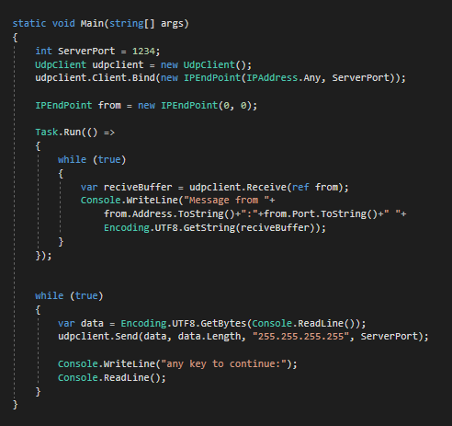
Multicasting in C#
In class 4 IP networks (the kind we use almost ever where,
We can use 255.255.255.255 to Multicast a packet to ever computer on the network.
But Multicast/broadcast packets will not be transmitted from one network to another, like our network to the internet. The routers prevent it. If they didn’t we fold all network with out broadcasts.

Slide 12
Peer discovery over the internet
So to use peer to peer over the internet, we still have to have a known centralised point to connect to.
This server doesn’t have to do much more than initialize handshakes between peers
Or we need peers to hold and pass on connection information of other peers they are connected to.
This is called a DHT (Decentralised Hash Table)
If we have neither of these, then we have no connections and we never will. ☹

Slide 13
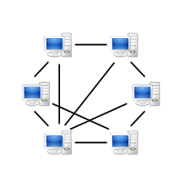
Once we have peer connection information, we can start dedicated connection between the two peers, just like client server
We can transmit with TCP or UDP.

Slide 14
Usage
File sharing / Bit torrents (legal only!)
Crypto currency's
FAROO ( a peer to peer search engine)
Tor
Windows 10. M$ use it to share windows updates, reducing the load on there servers. (its called Delivery Optimization).

Slide 15




In Games
Mass Effect Andromeda uses it for Coop
Metal gear online used it to share updates
For Honor and Elite dangerous use it instead of regular servers.

Slide 16
Issues with Peer to peer in games
There are many issues with peer to peer in games two of the big ones are:
Peers can disconnect for any reason (when there losing) and they just vanish. No server keeping track means no punishment
Peers can force there own world state on to others or just lie about there’s. no server means no policing.

Slide 17
Questions?

Slide 18
This week
Make a simple console based peer to peer chat system.
Send messages to each other using broadcasts.
If you see any problems, can you find a way to fix them?
Can you find a way for users to broadcast there presence on the network but allow for private messaging?

